Slide 1

AVR assembly
Summary

Slide 2
AVR Memory
Code memory : rom stores code
Data memory space:
GPRs : 32 general purpose Registers take the first 32 location.
I/O memory : special function registers SFRs like status register, I/O Ports..etc.
The next 64 address in the memory at least.
Could use the I/O address and start from 0.
Internal SRAM
All data has word length of 8 bit for Data Memory.
AVR ROM has word length of 2 Bytes.
The program counter has k bit word length where k is the number of the address buses.

Slide 3
Stack
A SECTION OF RAM USED BY THE CPU TO STORE INFORMATION TEMPORIARLY , THERE IS A REGISTER CALLED STACK POINTER POINTS TO STACK, IT IMPLEMENTED AS TWO REGISTERS SPH REPRESENTS THE HIGH BYTE OF SP AND SPL REPRESENTS THE LOW BYTE.
STOREING INFO. IN STACK CALLED PUSH WHETE LOADING INFO. FROM STACK CALLED POP.
PUSH Rr ; WHERE Rr IS ANY GPR , INC. AFTER PUSHING.
POP Rr ; DEC BEFORE LOADING.
INIT :
LDI R16 ,HIGH(RAMEND)
OUT SPH,R16
LDI R16,LOW(RAMEND)
OUT SPL,R16

Slide 4
Flags
C : Carry flag: set if there is a carry from D7 and D6 to D7
H : half carry flag: set if there is a carry from D3 to D4
Z : zero flag: set if the result of operation is 0
N : negative flag: set if D7 is 1 in signed number
V : overflow flag: set of the result of signed number is larger
S : sign flag: XOR(N,V)
TIFR Register contains :
TOV0: overflow timer flag for TCNT0
OCF0: the output compare flag for TCNT0

Slide 5
Assembler directive
.EQU : used to define constant value or fixed address
.SET : same as EQU but the value could reassign later
.ORG : used to indicate the beginning of the address
.INCLUDE “file name”: to import content of a file to program
.MACRO NAME >>> .END MACRO : create a function to reuse later
The basic Structure of assembly:
[Label:] mnemonic [operands] [;comments]
[OPTIONAL (NOT REQUIRED IN ALL INSTRUCTUIONS)]
Lapel field allows the program to find a line by its name

Slide 6
Instructions
LDI : load Register with immediate value (copies 8bit into GPR)
LDI Rd , k
16= < Rd < 32
K could be 8-bit decimal or hexadecimal or ascii.
ADD : TO add two values in GPR
ADD Rd,Rr ; Rd = Rd + Rr
Note that any arithmetic or logic operation done using GPRs
SUB : Subtract
SUB Rd,Rr ; Rd = Rd-Rr

Slide 7
CONT.
ADC : ADD WITH CARRY
ADC Rd,Rr ; Rd = Rd + Rr + 1
SBC : SUB WITH CARRY
SBC Rd,Rr ; Rd = Rd - Rr – 1
SUBI Rd,k ; Rd = Rd – k
SBCI Rd,k ; Rd = Rd - k – 1
SBIW Rd:Rd+1 ,k ; Rd:Rd+1 = Rd:Rd+1 –K
COULD USE SBIW Rd+1:Rd,k
THE RESULT STORED IN PAIR REGISTERS
USED ONLY WITH THE LAST 8 REGISTERS IN GPR

Slide 8
CONT.
MUL : MULTIPLICATION BYTE BY BYTE FOR UNSIGENED NUMPERS
MUL Rd,Rr
MULS Rd,Rr ; BYTE BY BYTE FOR SIGENED NUMPERS
MULSU Rd,Rr ; MUL signed with unsinged
The result stored in R1 for the higher byte and R0 for the lower.

Slide 9
Division instruction
There isn’t an instruction for division directly, so we have an algorithm to perform division using subtract and addition.
To divide x by y :
LDI NUM,x ; NUMERATOR (a GPR register defined to be NUM.)
LDI DEN,y ; DENEMRATOR (a GPR register defined to be DEN.)
CLR QUOTIENT (a GPR register defined to store the result.)
L1:INC QUOTIENT
SUB NUM,DEN ; subtract till get a negative
BRCC L1; BRANCE IF C CLEAR
DEC QUOTIENT ; undo last operation that make the result of num negative.
ADD NUM,DEN ; NUM store the remainder
Can use LSR to divide the number by 2 each time

Slide 10
Cont.
LDS : Load direct from data space
LDS Rd,k ; Rd = k
K is an address between $0000 to $ffff of the data memory space.
STS : Store direct to data space
STS k,Rr ; the content of the address k = Rr.
NOP : no operation (wastes a clock cycle)

Slide 11
CONT.
IN :
IN Rd,A ; Load a Standard I/O location (the next 64 after GPRs) to GPR
Each location of I/O has two address as we mentioned, and we can use the name of I/O address instead of writing the address when we import the address name file only works with those instructions that accepts I/O address.
IN Works with all AVRs and Faster than LDS also takes only 2 bytes.
OUT:
OUT A,Rr ; Store register to I/O Location.
It is like IN instruction, and it is faster than STS.

Slide 12
Cont.
MOV
MOV Rd,Rr ; Rd = Rr
Could use any of GPRs.
INC : increment
INC Rd ; Rd++
DEC : decrement
DEC Rd ; Rd—
TST : Set Zero flag if register contains )
TST Rd
There are some other ALU instructions like (AND,OR,EOR,ADC,SBC)

Slide 13
Cont.
CLR Rd ; Clear Register
COM Rd ; 1’s complement
NEG Rd ; 2’s complement
ROL Rd ; rotate left
ROR Rd ; rotate right
LSL Rd ; logical shift left
LSR Rd ; logical shift right
ASR Rd ; arithmetic shift right
SWAP Rd ; swap nibbles

Slide 14
JUMP / LOOP
JMP : Unconditional branching IN ± 4M BYTES (LONG JUMP)
JMP Label ; GO TO LABEL LINE
USED IN LOOPING
RJMP : same as JMP BUT LOWER SIZE ±2048 (MEDIUM JUMP)
IJMP
CONDITIONAL BRANCHING: SIZE ±64 BYTES. (SHORT JUMP)
BRNE : Branch if Z not Equal 1 (Z = 0)
BREQ : Branch if Z is set
BRSH/BRCC : branch if C clear
BRLO/BRCS : Branch if C set
BRPL : Branch if positive (N = 0)
BRMI : Branch if N set
BRVC : Branch if V clear
BRVS : Branch if V set

Slide 15
CALL
USED AS FUNCTION , YOU CAN CALL LABEL TO DO FUNCTION THEN RETURN.
CALL Label : as JMP used with size of 4M
TO MAKE SURE THAT AVR KNOWS WHERE TO GET BACK AFTER EXECUTION OF THE CALLED SUBROUTINE THE MICROCONTROLLER SAVES AUTOMATICLY THE ADDRESS OF THE NEXT INSTRUCTION ON THE STACK.
AFTER RETURN, THE TOP LOCATION OF STACK COPIED BACK TO THE PROGRAM COUNTER.
RCALL : as RJMP used size of 2048
ICALL

Slide 16
AVR PORTS
EACH PORT HAS 3 I/O REGISTERS:
DDRx: DATA DIRECTION REGISTER , EACH BIT REPRESENTS THE DIRECTION OF THE PIN IN THE RELEVANT PORT (0 FOR IN , AND 1 FOR OUT)
PORTx: OUTPUT PORT PIN
PINx: PORT INPUT PIN
IF DDRx NOT CONFIGURED THEN THE DATA WON’T SENT through PINS.

Slide 17
Single bit instruction for AVR
SBI ioReg,bit number ; set bit in the ioRegister
CBI ioReg,bit number ; clear bit in the ioRegister
SBIC ioReg,bit number ; skip next instruction if bit in the ioRegister clear
SBIS ioReg,bit number ; skip next instruction if bit in the ioRegister set
The I/O Register can be the lower I/O Register.

Slide 18
Timer
TCNTn Register for timer and counter (TCNT0 is 8-bit timer register)
XTAL (Oscillator frequency), T = 1/F (the time for each tick)
Timer control register TCCRn for setting modes of operations
In TCCR0 :
D2:D0 USED TO CHOOSE CLK SOURCE (0 TO STOP , 001 no perscaling & 010-101 for internal perscaling while 110 for external clk falling & 111 raising)
D6,D3 : 00 to set normal mode
D5,D4 : used to compare output mode
Output compare Register OCRn the content of it compared with TCNTn and if equal then the OCFn(output compare flag will be set)
All the Timer Registers located in I/O Registers so can use IN/OUT..etc

Slide 19
Steps to program a timer in normal mode
Load the TCNT0 with initial value
Load a value to TCCR0 register to setup modes
Keep monitoring TOV0 flag and get out of loop when it set
Stop timer (set mode TCCR0 = 0)
Clear TOV0 flag (set 1 to it and 0 to other bits in TIFR)
Delay = number of count * T = (FF – xx +1) * T = (256-NNN) * T

Slide 20
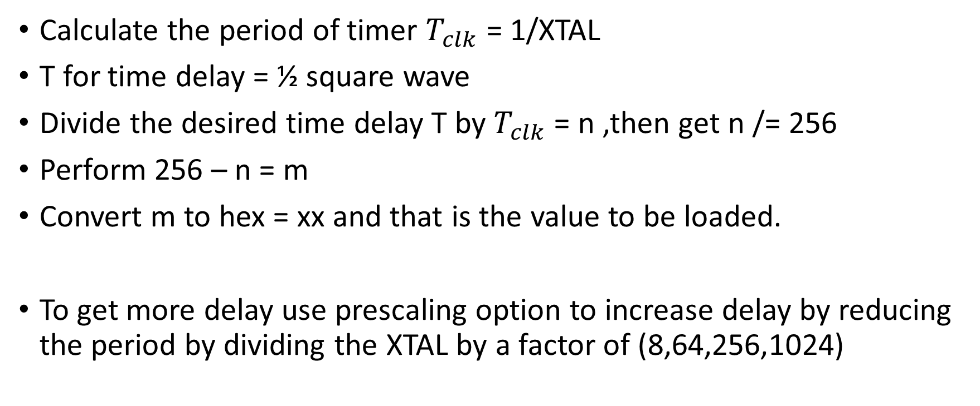
Find a value to be loaded into the timer
Calculate the period of timer $T_{clk}$ = 1/XTAL
T for time delay = ½ square wave
Divide the desired time delay T by $T_{clk}$ = n ,then get n /= 256
Perform 256 – n = m
Convert m to hex = xx and that is the value to be loaded.
To get more delay use prescaling option to increase delay by reducing the period by dividing the XTAL by a factor of (8,64,256,1024)

